Slide 1
PROGRESS REPORT ON ML-assisted Signal Quality Assessment of PPG Signals With Related Hardware Implementation
Presented By:
Archana Kumari
Univ. Roll no.– T91/ECE/204058
Univ Registration no.– D01-1211-0077-20
Shwashwat Das
Univ Roll no.– T91/ECE/204074
Univ Registration no.– D01-1111-0206-20
B.Tech in Electronics and Communication Engineering
Supervisor:
Dr. SUMITRA MUKHOPADHYAY
(Department of Radio Physics and Electronics, University of Calcutta)

Slide 2
Agenda
Papers reviews
Annotation
One shot learning theory
Embedded C basics

Slide 3
Literature Review
Table 1: Some selected previous research work on the field of Signal Quality Assessment
S. No. | Paper Name | Dataset used | Segmentation Type | Intra/Inter patient | Model Used
 | Photoplethysmography signal quality assessment using attractor reconstruction analysis, 2023 | MIMIC III | Non beat – 3sec segments | Intra | Attractor reconstruction analysis
2. | Lightweight Photoplethysmography Quality Assessment for Real-time IoT-based Health Monitoring using Unsupervised Anomaly Detection, 2021 | Datset collected from 5 female using samsung smartwatch | Non beat – 30sec segments | Both | Elliptic envelope algorithm (an unsupervised method)
3. | Robust PPG motion artifact detection using a 1-D convolution neural network, 2020 | 4 datasets, total 18742 samples | Non beat – 5sec segments | Intra | 1D - CNN
4. | On Device Integrated PPG Quality Assessment and Sensor Disconnection Saturation Detection System for IoT Health Monitoring, 2020 | 5 datasets; 3000 segments for analysis; 30000 segments for validation | Non beat – 5sec segments | Intra | Hierarchical decision rules
5. | A Supervised Approach to Robust Photoplethysmography Quality Assessment, 2020 | Physionet | Non beat – 30sec segments | Inter | k-NN, DT, Two class SVM

Slide 4
Continued…
S. No. | Paper Name | Dataset used | Segmentation type | Inter/Intra patient | Model used
6. | An energy-efficient semi-supervised approach for on-device photoplethysmogram signal quality assessment, 2023 | Collected from 46 individuals using Samsung smartwatch | non beat(30sec) | Inter - train(32), test(14) | OCSVM
7. | Optimized Signal Quality Assessment for Photoplethysmogram Signals Using Feature Selection, 2022 | Collected in a multi-phase study called Pulsewatch, UMMC Simband Dataset, MIMIC III | non beat(30sec) | NA | Ensemble feature selection technique
8. | Deep convolutional neural network-based signal quality assessment for photoplethysmogram, 2022 | MIMIC-III Waveform Database | non beat(5sec) | Inter (Train – 80%, Test – 20%), Cross Validation(5 groups) | CNN
9. | Real-Time PPG Signal Quality Assessment System for Improving Battery Life and False Alarms, 2019 | 38620 samples | non beat(5sec) | NA | Decision based
10. | Optimal Signal Quality Index for Photoplethysmogram Signals, 2016 | 106 samples | non beat(60sec) | NA | Feature based

Slide 5
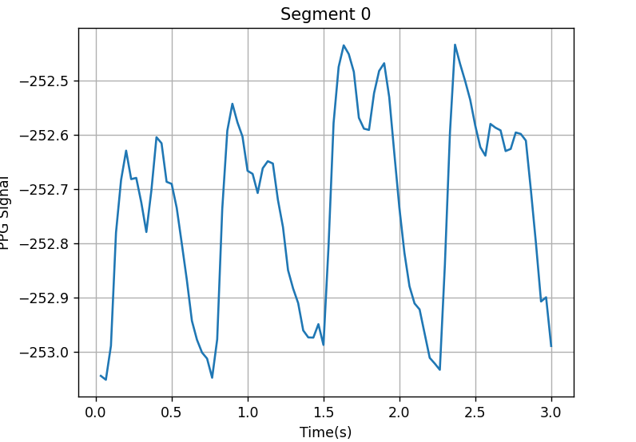
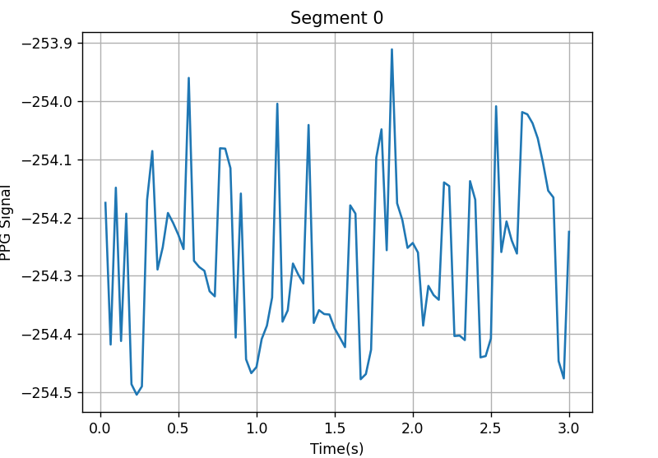
Annotations steps:
Take the signal of a subject
Segment it into windows(say 3s)
Write a code it to move it to a excel/csv file
Visualize the plot of the segment
Add the annotation values to Row-0 [0(clean)/1(partly clean)/2(corrupted)]
Make individual files for individual subjects(alternatively, write the segments as 0-1, 0-2)
Fig 1: Partly corrupted segment
Fig2 : Corrupted segment

Slide 6
One Shot Learning
N-Shot Learning is a family of methods/algorithms/networks where the models learns from N examples where N is very small number.
One-Shot Learning: The model is trained on 1 sample each from every class
Two-Shot Learning: The model is trained on 2 samples each from every class
Few Shot Learning: The model is trained on N(very low) samples from each class
Importance of one shot learning: Human-Like Learning, adaptability,
Working:
Data preparation: 1 example from each class
Feature extraction: Distinctive patterns extraction
Model: Neural network like Siamese networks, Triplet networks
Training: Model learns from similarity and dissimilarity computed in the feature space, adjust parameters(weights and biases)
Inference: For unseen data, model compares its feature vectors from the known dataset
Evaluation: Using performance metrics

Slide 7
Embedded C Basics:
An extension to the Standard C Programming Language.
It has additional features like Addressing I/O, multiple memory addressing and fixed-point arithmetic, etc.
C language has low time complexity and low space complexity.
Robust, scalable and versatile, and easy maintenance of code.
STM32 microcontroller boards easily supports with Embedded C language.
Some differences of C and Embedded C languages:
S. No. | C programming | Embedded C programming
1. | General-purpose programming language | Tailored for programming embedded systems
2. | Deals with system's available memory. | Manages limited embedded system memory efficiently
3. | Hardware independent | Fully hardware dependent

